Slide 1


Digital Logic Circuits

Slide 2






Computer Architecture
is concerned with the structure and behavior of the computer from the user’s point of view.
It is the external view of the computer that anyone who is likely to program a computer should understand.
Computer Organization
is concerned with the way that hardware components operate and the way they are connected to form the computer.
It is the internal view of the computer and the roles various internal components play during program execution.
Computer Design
is concerned with the hardware design of the computer.
It is concerned with decisions like which hardware should be used and how they should be connected.

Slide 3
In this lecture, we will study
Logic gates
Boolean algebra
K-maps and K-map simplification
Combinational circuits (half adder, full adder)

Slide 4

Logic Gates

Slide 5
Logic Gates
In order to manipulate binary information, logic circuits called gates are required.
Gates are blocks of hardware that produce an output of either 0 or 1, depending on the given inputs.

Slide 6
AND
OR
Inverter (aka NOT)
Buffer
Types of Logic Gates
NAND
NOR
Exclusive OR (XOR)
Exclusive NOR (XNOR)

Slide 7
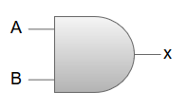

Logic Gates
Name
Symbol
Algebraic Function
Truth Table
A B x
x=A*B or x=AB
AND
0 0 0
0 1 0
1 0 0
1 1 1
A B x
OR
x=A+B
0 0 0
0 1 1
1 0 1
1 1 1

Slide 8


Logic Gates
Name
Symbol
Algebraic Function
Truth Table
A
x
Inverter (aka NOT)
x
x=A’
0
1
1
0
A
x
Buffer
x
x=A
0 0
1 1

Slide 9
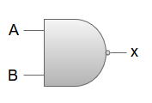

Logic Gates
Name
Symbol
Algebraic Function
Truth Table
A B x
NAND (Not AND)
0 0 1
0 1 1
1 0 1
1 1 0
x=(AB)’
A B x
NOR (Not OR)
x=(A+B)’
0 0 1
0 1 0
1 0 0
1
1
0

Slide 10
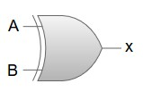

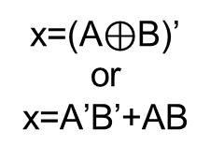

Logic Gates
Name
Symbol
Algebraic Function
Truth Table
A B x
Exclusive OR (XOR)
x=A$⨁$B
or
x= A’B+AB’
0 0 0
0 1 1
1 0 1
1 1 0
A B x
Exclusive NOR (XNOR)
x=(A$⊕$B)’
or x=A’B’+AB
0 0 1
0 1 0
1 0 0
1
1
0

Slide 11

Exercise
Draw a logic diagram for the following Boolean expression:
F=AB+A’C

Slide 12

Exercise
F=AB+A’C
A
AB
B
A
AC
C

Slide 13
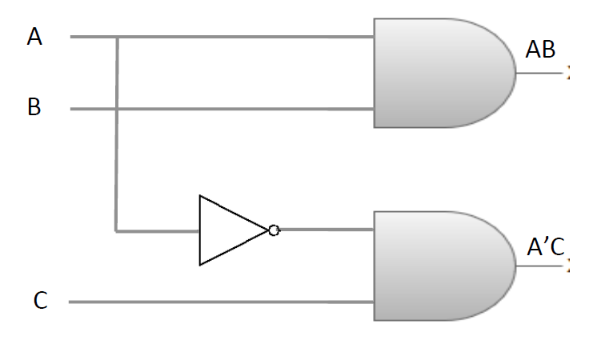
Exercise
F=AB+A’C

Slide 14
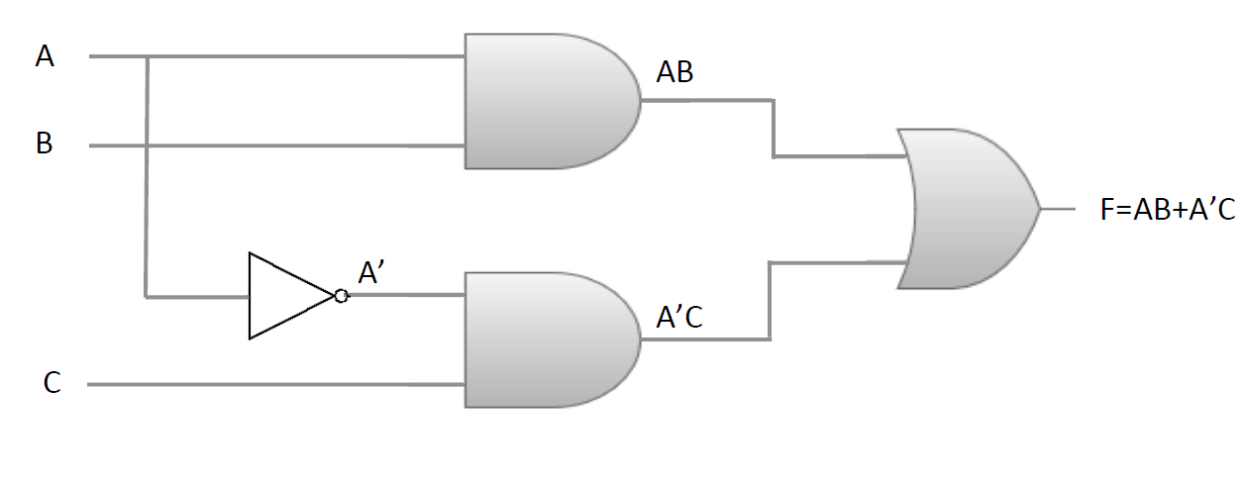
Exercise

Slide 15

Boolean Algebra

Slide 16

Boolean algebra is the algebra that deals with binary variables and logic operations.
Binary Variables: A, B, x, y, etc.
Basic Logic Operation: AND, OR, Complement

Slide 17
A boolean function is expressed using binary variables, logic operation symbols, paratheses, and an equal sign (=).
For instance,
F = x+y’z
is a boolean function, where the function F is equal to 1 if x is 1 or if both y’ and z are equal to 1, and 0 otherwise.

Slide 18
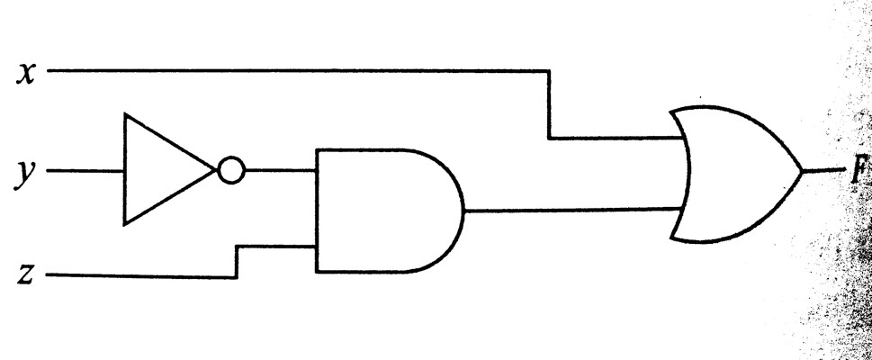
Other Representations of a Boolean Function
Algebraic Logic Diagram Truth Table Expression
x | y | z | F
0 | 0 | 0 | 0
0 | 0 | 1 | 1
0 | 1 | 0 | 0
0 | 1 | 1 | 0
1 | 0 | 0 | 1
1 | 0 | 1 | 1
1 | 1 | 0 | 1
1 | 1 | 1 | 1
F = x + y’ z

Slide 19

Identities and DeMorgan’s Theorem

Slide 20
Identities: List of axioms and theorems
Identity | A + 0 = A | A. 1 = A
Complement | A + A’ = 1 | A. A’ = 0
Commutative | A + B = B + A | A. B = B. A
Assosiative | A + (B + C) = (A + B) + C | A. (B. C) = (A. B). C
Distributive | A. (B + C) = A. B + A. C | A + (B. C) = (A + B). (A + C)
Null Element | A + 1 = 1 | A. 0 = 0
Involution | (A’)’ = A
Indempotency | A + A = A | A. A = A
Absorption | A + (A. B) = A | A. (A + B) = A
Distributive | A + A’. B = A + B | A’ + A.B = A’ + B
De Morgan’s | (A + B)’ = A’. B’ | (A. B)’ = A’+ B’

Slide 21
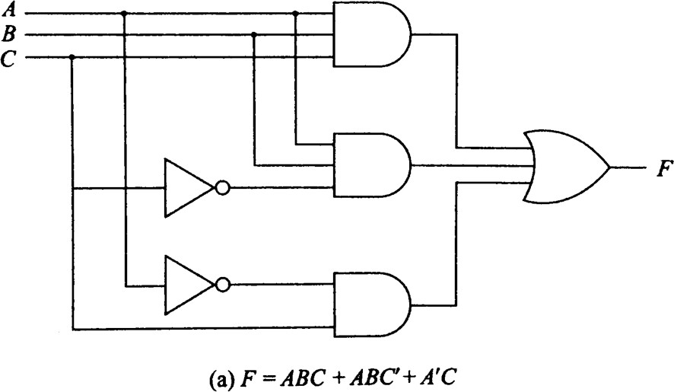
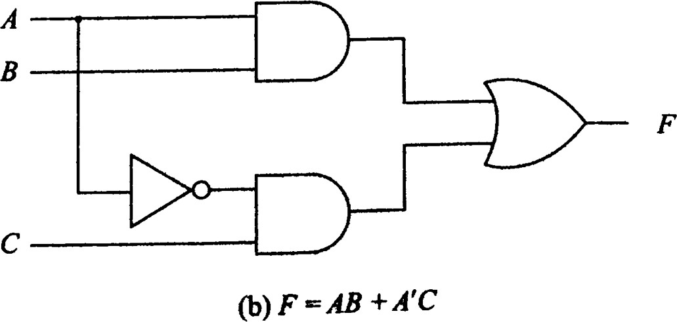

Slide 22
F= ABC+ABC’+A’C F= AB(C+C’)+A’C F= AB(1)+A’C
F= AB+A’C

Slide 23

DeMorgan’s Theorem is crucial for dealing with NAND and NOR gates.
NOR gate: The function (x+y)’ is equivalent to (x’y’).
NAND gate: The function (xy)’ is equivalent to (x’+y’).
For this reason, NOR and NAND gates haves two distinct graphical symbols.

Slide 24
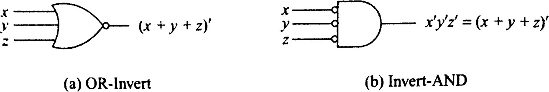
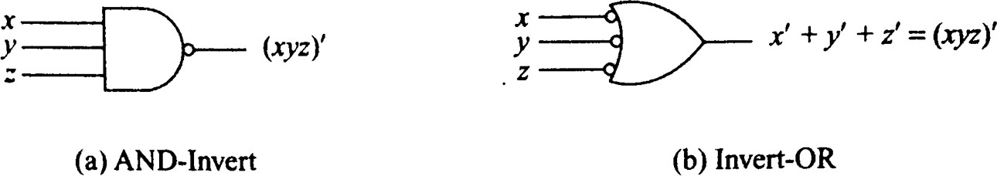
Two graphical symbols for NOR gate
Two graphical symbols for NAND gate
Both NOR and NAND gates are called UNIVERSAL GATES

Slide 25
K-Maps

Slide 26

Why K-Maps?
Increase in complexity of Boolean algebraic expression
Increase in complexity of logic diagram
Complexity can be reduced by simplifying the Boolean algebraic expression
with the help of Karnaugh Map or K-Map.

Slide 27
K (Karnaugh)-maps
Maurice Karnaugh introduced it in 1953
K Map is a graphical representation used for simplifying the Boolean expressions.
For a Boolean expression consisting of n-variables, the number of cells required in K Map = 2^{n} cells.
K Map is based on the Grey code(Unit distance code).
K Map is based on three types of Input values(0, 1, don't care)

Slide 28
Minterms
A minterm is a Boolean expression resulting in 1 for the output of a single cell, and 0s for all other cells in a Karnaugh map or a truth table.
A B C F
In this sample truth table, we have five minterms, namely:
A’B’C, AB’C’, AB’C, ABC’, and ABC
(because for F= A’B’C, F=AB’C’, F=AB’C, F=ABC’, and F=ABC , the
output is 1, and for all other Boolean expressions, the output is 0).
0 | 0 | 0 | 0
0 | 0 | 1 | 1
0 | 1 | 0 | 0
0 | 1 | 1 | 0
1 | 0 | 0 | 1
1 | 0 | 1 | 1
1 | 1 | 0 | 1
1 | 1 | 1 | 1

Slide 29
Representing Truth Tables as Minterms
A | B | C | F
0 | 0 | 0 | 0
0 | 0 | 1 | 1
0 | 1 | 0 | 0
0 | 1 | 1 | 0
1 | 0 | 0 | 1
1 | 0 | 1 | 1
1 | 1 | 0 | 1
1 | 1 | 1 | 1
=
F(A, B, C) = Σ (1, 4, 5, 6, 7)
Here, the cells 1, 4, 5, 6, and 7 represent the minterms.

Slide 30

K-Maps
A | B | C | F
0 | 0 | 0 | 0
0 | 0 | 1 | 1
0 | 1 | 0 | 0
0 | 1 | 1 | 0
1 | 0 | 0 | 1
1 | 0 | 1 | 1
1 | 1 | 0 | 1
1 | 1 | 1 | 1
=
A
F(A, B, C) = Σ (1, 4, 5, 6, 7)
B, C
00
01
11
10
0 | 0 | 1 | 1 | 3 | 0 | 2 | 0
4 |  | 5 |  | 7 |  | 6
 | 1 |  | 1 |  | 1 |  | 1
0
1

Slide 31



K-Maps for 2, 3, and 4 variable functions
B
A
B, C
0
1
0
1
A
00
01
11
10
0 | 1
2 | 3
0
1
0 | 1 | 3 | 2
4 | 5 | 7 | 6
C, D
A, B
00
01
11
10
00
01
11
10
0 | 1 | 3 | 2
4 | 5 | 7 | 6
12 | 13 | 15 | 14
8 | 9 | 11 | 10

Slide 32
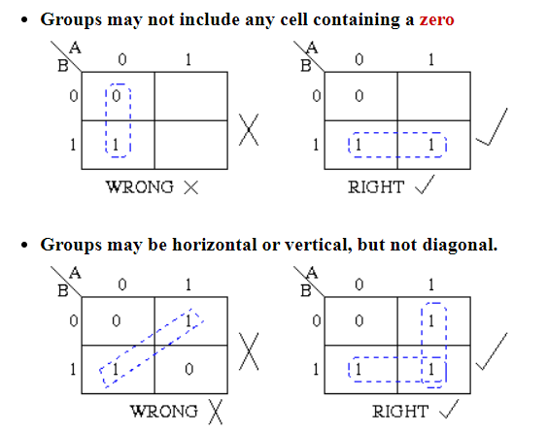
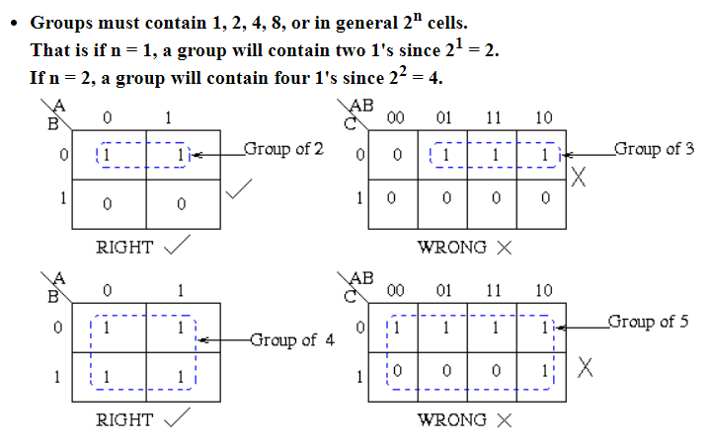
Karnaugh Maps - Rules of Simplification

Slide 33
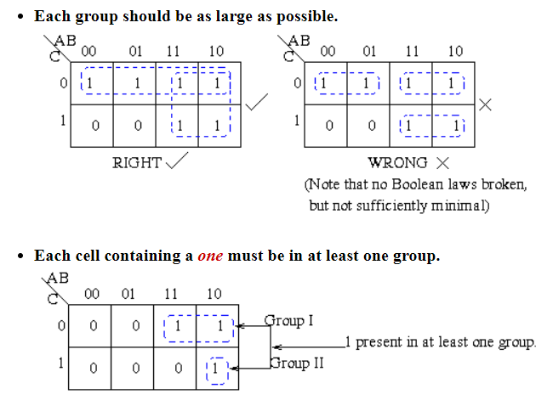
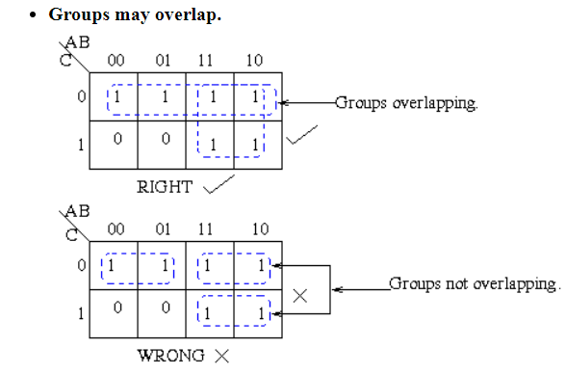
Karnaugh Maps - Rules of Simplification

Slide 34
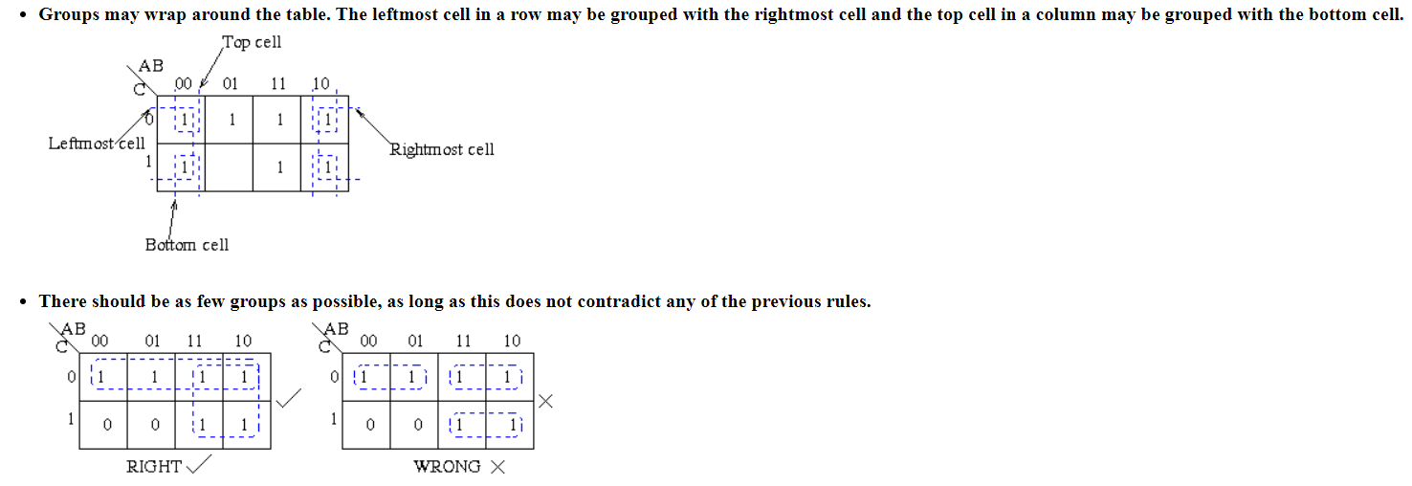
Karnaugh Maps - Rules of Simplification

Slide 35



K-Map Simplification
F(A, B, C) = Σ (3, 4, 6, 7)
B, C
A
00
01
11
10
0 | 0 | 1 | 0 | 3 | 1 | 2 | 0
4 |  | 5 |  | 7 |  | 6
 | 1 |  | 0 |  | 1 |  | 1
0
1

Slide 36



K-Map Simplification
F(A, B, C) = Σ (3, 4, 6, 7)
B, C
A
00
01
11
10
0 | 0 | 1 | 0
1 | 0 | 1 | 1
0
1

Slide 37








K-Map Simplification
B, C
A
0
00 | 01 | 11 | 10
0 | 0 | 1 | 0
1 | 0 | 1 | 1
1
F= BC+ AC’

Slide 38



K-Map Simplification
B, C
A
0
00 | 01 | 11 | 10
0 | 0 | 1 | 0
1 | 0 | 1 | 1
Consider Essential prime implicants
1
F= BC+ AC’ + AB
Additional term

Slide 39



K-Map Simplification
F(A, B, C, D) = Σ (0, 2, 5, 7, 8, 10, 13, 15)
C, D
A, B
00
01
11
10
00
01
11
10
1 | 0 | 0 | 1
0 | 1 | 1 | 0
0 | 1 | 1 | 0
1 | 0 | 0 | 1

Slide 40



K-Map Simplification
F(A, B, C, D) = Σ (0, 2, 5, 7, 8, 10, 13, 15)
C, D
A, B
00
01
11
10
00
01
11
10
1 | 0 | 0 | 1
0 | 1 | 1 | 0
0 | 1 | 1 | 0
1 | 0 | 0 | 1

Slide 41




K-Map Simplification
C, D
00 01 11 10
A, B
1 0 0 1
0 1 1 0
0 1 1 0
10 1 0 0 1
00
01
11
F= BD+ B’D’
(other solutions are also possible)
38

Slide 42
Exercise
F(A, B, C, D) = Σ (1, 3, 4, 5, 6, 9, 11, 12, 13, 14)

Slide 43
Exercise
F(A, B, C, D) = Σ (1, 3, 4, 5, 6, 9, 11, 12, 13, 14)
C, D
A, B
00
01
11
10
00
01
11
10
0 | 1 | 1 | 0
1 | 1 | 0 | 1
1 | 1 | 0 | 1
0 | 1 | 1 | 0

Slide 44
Exercise
F(A, B, C, D) = Σ (1, 3, 4, 5, 6, 9, 11, 12, 13, 14)
C, D
A, B
00
01
11
10
00
0
1
1
0
1
1
0
1
01
1
1
0
1
11
0
1
1
0
10
41

Slide 45

Exercise
C, D
A, B
00
01
11
10
00 0
1
1
0
1
1
0
1
01
1
1
0
1
11
0
1
1
0
10
F= BC'+B'D+BCD’

Slide 46



The maps we have seen so far can also be referred to as the ‘SUM OF PRODUCTS’ form of K-Maps
C, D
00 01 11 10
A, B
00
0 1 1 0
1 1 0 1
1 1 0 1
0 1 1 0
01
F= BC+B’D+BCD’
(other solutions are also possible)
11
10
F(A, B, C, D) = Σ (1, 3, 4, 5, 6, 9, 11, 12, 13, 14)

Slide 47
Another Representation of K-Maps:
Product of Sums (POS)
A | B | C | F
0 | 0 | 0 | 0
0 | 0 | 1 | 1
0 | 1 | 0 | 0
0 | 1 | 1 | 0
1 | 0 | 0 | 1
1 | 0 | 1 | 1
1 | 1 | 0 | 1
1 | 1 | 1 | 1
=
F(A, B, C) = Π (0, 2, 3)

Slide 48
Maxterms
A maxterm is a Boolean expression resulting in 0 for the output of a single cell, and 1s for all other cells in a Karnaugh map or a truth table.
A B C F
In this sample truth table, we have three maxterms, namely:
A+B+C, A+B'+C, and A+B'+C'
(because for A+B+C, A+B'+C, and A+B'+C', the output is 0, and for all other Boolean expressions, the output is 1).
0 | 0 | 0 | 0
0 | 0 | 1 | 1
0 | 1 | 0 | 0
0 | 1 | 1 | 0
1 | 0 | 0 | 1
1 | 0 | 1 | 1
1 | 1 | 0 | 1
1 | 1 | 1 | 1

Slide 49
Representing Truth Tables as Maxterms
A | B | C | F
0 | 0 | 0 | 0
0 | 0 | 1 | 1
0 | 1 | 0 | 0
0 | 1 | 1 | 0
1 | 0 | 0 | 1
1 | 0 | 1 | 1
1 | 1 | 0 | 1
1 | 1 | 1 | 1
=
F(A, B, C) = Π (0, 2, 3)
Here, the cells 0, 2, and 3 represent the maxterms.

Slide 50





C, D
A, B
00
01
11
10
00
01
0 | 1 | 1 | 0
1 | 1 | 0 | 1
1 | 1 | 0 | 1
0 | 1 | 1 | 0
SUM OF PRODUCTS
11
PRODUCT of SUMS
10
F(A, B, C, D) = Σ (1, 3, 4, 5, 6, 9
11, 12, 13, 14)
F(A, B, C, D) = Π (0, 2, 7, 8, 10, 15)

Slide 51
POS Simplification
F(A, B, C, D) = Π (3, 6, 7, 11, 12, 13, 14, 15)
C, D
A, B
00
01
11
10
00
01
11
10
1 | 1 | 0 | 1
1 | 1 | 0 | 0
0 | 0 | 0 | 0
1 | 1 | 0 | 1

Slide 52
POS Simplification
F(A, B, C, D) = Π (3, 6, 7, 11, 12, 13, 14, 15)
C, D
A, B
00
01
11
10
00
1
1
0
1
1
1
0
0
01
0
0
0
0
11
1
1
0
1
10
49

Slide 53


POS Simplification
C, D
00 01 11 10
A, B
00
1 1 0 1
1 1 0 0
0 0 0 0
1 1 0 1
01
11
10
F= (C’+D’) (A’+B’) (B’+C’)
(other solutions are also possible)
50

Slide 54


5-Variable K-Maps
A = 0
A = 1
D, E
D, E
00
01
11
10
B, C
00
01
11
10
B, C
0 | 1 | 3 | 2
4 | 5 | 7 | 6
12 | 13 | 15 | 14
8 | 9 | 11 | 10
00
16 | 17 | 19 | 18
20 | 21 | 23 | 22
28 | 29 | 31 | 30
24 | 25 | 27 | 26
00
01
01
11
11
10
10
Cell 0 can be considered to be ‘adjacent’ to cell 16, cell 1 can be considered to be adjacent to cell 17, and so on.

Slide 55
Simplification of 5-Variable K-Maps
F(A, B, C, D, E) = Σ (1, 2, 3, 5, 7, 11, 13, 17, 19, 23, 29, 31)
Or
^{F(A, B, C, D, E)= m}1^{, m}2^{, m}3, ^{m}5, ^{m}7, ^{m}11, ^{m}13, ^{m}17, ^{m}19, ^{m}23, ^{m}29, ^{m}31

Slide 56


Simplification of 5-Variable K-Maps: Step 1
F(A, B, C, D, E) = Σ (1, 2, 3, 5, 7, 11, 13, 17, 19, 23, 29, 31)
A = 0
A = 1
D, E
D, E
00
01
11
10
B, C
00
01
11
10
B, C
0 | 1 | 1 | 1
0 | 1 | 1 | 0
0 | 1 | 0 | 0
0 | 0 | 1 | 0
00
0 | 1 | 1 | 0
0 | 0 | 1 | 0
0 | 1 | 1 | 0
0 | 0 | 0 | 0
00
01
01
11
11
10
10

Slide 57


Simplification of 5-Variable K-Maps: Step 2
F(A, B, C, D, E) = Σ (1, 2, 3, 5, 7, 11, 13, 17, 19, 23, 29, 31)
A = 0
A = 1
D, E
D, E
00
01
11
10
B, C
00
01
11
10
B, C
0 | 1 | 1 | 1
0 | 1 | 1 | 0
0 | 1 | 0 | 0
0 | 0 | 1 | 0
00
0 | 1 | 1 | 0
0 | 0 | 1 | 0
0 | 1 | 1 | 0
0 | 0 | 0 | 0
00
01
01
11
11
10
10
A’B’E
54

Slide 58
Simplification of 5-Variable K-Maps: Step 3
F(A, B, C, D, E) = Σ (1, 2, 3, 5, 7, 11, 13, 17, 19, 23, 29, 31)
A = 0
A = 1
D, E
D, E
00 | 01 | 11 | 10
0 | 1 | 1 | 1
0 | 1 | 1 | 0
0 | 1 | 0 | 0
0 | 0 | 1 | 0
B, C
00
01
11
10
B, C
00
0 | 1 | 1 | 0
0 | 0 | 1 | 0
0 | 1 | 1 | 0
0 | 0 | 0 | 0
00
01
01
11
11
10
10
A’B’E+ A’B’C’D
55

Slide 59
Simplification of 5-Variable K-Maps: Step 4
F(A, B, C, D, E) = Σ (1, 2, 3, 5, 7, 11, 13, 17, 19, 23, 29, 31)
A = 0
A = 1
D, E
D, E
00 | 01 | 11 | 10
0 | 1 | 1 | 1
0 | 1 | 1 | 0
0 | 1 | 0 | 0
0 | 0 | 1 | 0
B, C
00
01
11
10
B, C
00
0 | 1 | 1 | 0
0 | 0 | 1 | 0
0 | 1 | 1 | 0
0 | 0 | 0 | 0
00
01
01
11
11
10
10
A’B’E+ A’B’C’D+A’CD’E
56

Slide 60
Simplification of 5-Variable K-Maps: Step 5
F(A, B, C, D, E) = Σ (1, 2, 3, 5, 7, 11, 13, 17, 19, 23, 29, 31)
A = 0
A = 1
D, E
D, E
00
01
11
10
B, C
00
01
11
10
B, C
0
1
1
1
00
0 | 1 | 1 | 0
0 | 0 | 1 | 0
0 | 1 | 1 | 0
0 | 0 | 0 | 0
00
0
1
1
0
01
01
0
1
0
0
11
11
0
0
1
0
10
10
A’B’E+ A’B’C’D+A’CD’E+A’C’DE
57

Slide 61
Simplification of 5-Variable K-Maps: Step 6
F(A, B, C, D, E) = Σ (1, 2, 3, 5, 7, 11, 13, 17, 19, 23, 29, 31)
A = 0
A = 1
D, E
D, E
00
01
11
10
B, C
00
01
11
10
B, C
0
1
1
1
00
0 | 1 | 1 | 0
0 | 0 | 1 | 0
0 | 1 | 1 | 0
0 | 0 | 0 | 0
00
0
1
1
0
01
01
0
1
0
0
11
11
0
0
1
0
10
10
A’B’E+ A’B’C’D+A’CD’E+A’C’DE
AB’DE
58

Slide 62
Simplification of 5-Variable K-Maps: Step 7
F(A, B, C, D, E) = Σ (1, 2, 3, 5, 7, 11, 13, 17, 19, 23, 29, 31)
A = 0
A = 1
D, E
D, E
00
01
11
10
B, C
00
01
11
10
B, C
0
1
1
1
00
0
1
1
0
00
0
1
1
0
01
0
0
1
0
01
0
1
0
0
11
0
1
1
0
11
0
0
1
0
0
0
0
0
10
10
A’B’E+ A’B’C’D+A’CD’E+A’C’DE
AB’DE+ABCE
59

Slide 63

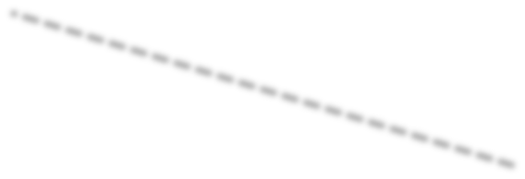
Simplification of 5-Variable K-Maps: Step 8
F(A, B, C, D, E) = Σ (1, 2, 3, 5, 7, 11, 13, 17, 19, 23, 29, 31)
A = 0
A = 1
D, E
D, E
00
01
11
10
B, C
00
01
11
10
B, C
0
1
1
1
00
0
1
1
0
00
0
1
1
0
01
0
0
1
0
01
0
1
0
0
11
0
1
1
0
11
0
0
1
0
0
0
0
0
10
10
A’B’E+ A’B’C’D+A’CD’E+A’C’DE
B’C’E
AB’DE+ABCE
60

Slide 64


Simplification of 5-Variable K-Maps: Solution
F(A, B, C, D, E) = Σ (1, 2, 3, 5, 7, 11, 13, 17, 19, 23, 29, 31)
F = A’B’E+ A’B’C’D+A’CD’E+A’C’DE+B’C’E+AB’DE+ABCE

Slide 65
Alternative Representations of 5-Variable K-Maps
Reflection Maps Overlay Maps

Slide 66


5-Variable Reflection K-Map
C, D, E
A, B
000 001 011 010 110 111 101 100
00
01
11
10
0 | 1 | 3 | 2 | 6 | 7 | 5 | 4
8 | 9 | 11 | 10 | 14 | 15 | 13 | 12
24 | 25 | 27 | 26 | 30 | 31 | 29 | 28
16 | 17 | 19 | 18 | 22 | 23 | 21 | 20
Think of this line as a mirror

Slide 67

Simplification of Reflection Map: Step 1
F(A, B, C, D, E) = Σ (1, 2, 3, 5, 7, 11, 13, 17, 19, 23, 29, 31)
C, D, E
A, B
000 001 011 010 110 111 101 100
00
01
11
10
0 | 1 | 1 | 1 | 0 | 1 | 1 | 0
0 | 0 | 1 | 0 | 0 | 0 | 1 | 0
0 | 0 | 0 | 0 | 0 | 1 | 1 | 0
0 | 1 | 1 | 0 | 0 | 1 | 0 | 0

Slide 68

Simplification of Reflection Map: Step 2
F(A, B, C, D, E) = Σ (1, 2, 3, 5, 7, 11, 13, 17, 19, 23, 29, 31)
C, D, E
A, B
 | 000 | 001 | 011 | 010 | 110 | 111 | 101 | 100
00 | 0 | 1 | 1 | 1 | 0 | 1 | 1 | 0
01 | 0 | 0 | 1 | 0 | 0 | 0 | 1 | 0
11 | 0 | 0 | 0 | 0 | 0 | 1 | 1 | 0
0
1
1
0
0
1
0
0
10
B’C’E

Slide 69
Simplification of Reflection Map: Step 3
F(A, B, C, D, E) = Σ (1, 2, 3, 5, 7, 11, 13, 17, 19, 23, 29, 31)
C, D, E
A, B
 | 000 | 001 | 011 | 010 | 110 | 111 | 101 | 100
00 | 0 | 1 | 1 | 1 | 0 | 1 | 1 | 0
01 | 0 | 0 | 1 | 0 | 0 | 0 | 1 | 0
11 | 0 | 0 | 0 | 0 | 0 | 1 | 1 | 0
0
1
1 0 0 1
B’C’E+A’B’C’D
0
0
10

Slide 70
Simplification of Reflection Map: Step 4
F(A, B, C, D, E) = Σ (1, 2, 3, 5, 7, 11, 13, 17, 19, 23, 29, 31)
C, D, E
A, B
000 001 011 010 110 111 101 100
0 1 1 1 0 1 1 0
0 0 1 0 0 0 1 0
0 0 0 0 0 1 1 0
0 1 1 0 0 1 0 0
B’C’E+A’B’C’D+A’C’DE
00
01
11
10

Slide 71
Simplification of Reflection Map: Step 5
F(A, B, C, D, E) = Σ (1, 2, 3, 5, 7, 11, 13, 17, 19, 23, 29, 31)
C, D, E
A, B
000 001 011 010 110 111 101 100
0 1 1 1 0 1 1 0
0 0 1 0 0 0 1 0
0 0 0 0 0 1 1 0
0 1 1 0 0 1 0 0
00
01
11
10
B’C’E+A’B’C’D+A’C’DE+ABCE

Slide 72


Simplification of Reflection Map: Step 6
F(A, B, C, D, E) = Σ (1, 2, 3, 5, 7, 11, 13, 17, 19, 23, 29, 31)
C, D, E
A, B
000 001 011 010 110 111 101 100
0 1 1 1 0 1 1 0
0 0 1 0 0 0 1 0
0 0 0 0 0 1 1 0
0 1 1 0 0 1 0 0
00
01
11
10
B’C’E+A’B’C’D+A’C’DE+ABCE+A’B’E

Slide 73


Simplification of Reflection Map: Step 7
F(A, B, C, D, E) = Σ (1, 2, 3, 5, 7, 11, 13, 17, 19, 23, 29, 31)
C, D, E
A, B
000 001 011 010 110 111 101 100
0 1 1 1 0 1 1 0
0 0 1 0 0 0 1 0
0 0 0 0 0 1 1 0
0 1 1 0 0 1 0 0
B’C’E+A’B’C’D+A’C’DE+ABCE+A’B’E+A’CD’E
00
01
11
10
70

Slide 74


Simplification of Reflection Map: Step 8
F(A, B, C, D, E) = Σ (1, 2, 3, 5, 7, 11, 13, 17, 19, 23, 29, 31)
C, D, E
A, B
000 001 011 010 110 111 101 100
0 1 1 1 0 1 1 0
0 0 1 0 0 0 1 0
0 0 0 0 0 1 1 0
0 1 1 0 0 1 0 0
00
01
11
10
B’C’E+A’B’C’D+A’C’DE+ABCE+A’B’E+A’CD’E+AB’DE

Slide 75
Overlay Maps?

Slide 76
5-Variable Overlay K-Map
C, D, E
A, B
000 001 011 010 100 101 111 110
00
01
11
10
0 | 1 | 3 | 2 | 4 | 5 | 7 | 6
8 | 9 | 11 | 10 | 12 | 13 | 15 | 14
24 | 25 | 27 | 26 | 28 | 29 | 31 | 30
16 | 17 | 19 | 18 | 20 | 21 | 23 | 22

Slide 77


5-Variable Reflection K-Map
5-Variable Overlay K-Map
C, D, E
000 001 011 010 110 111 101 100
C, D, E
000 001 011 010 100 101 111 110
A, B
A, B
0 | 1 | 3 | 2 | 6 | 7 | 5 | 4
8 | 9 | 11 | 10 | 14 | 15 | 13 | 12
24 | 25 | 27 | 26 | 30 | 31 | 29 | 28
16 | 17 | 19 | 18 | 22 | 23 | 21 | 20
0 | 1 | 3 | 2 | 4 | 5 | 7 | 6
8 | 9 | 11 | 10 | 12 | 13 | 15 | 14
24 | 25 | 27 | 26 | 28 | 29 | 31 | 30
16 | 17 | 19 | 18 | 20 | 21 | 23 | 22
00
00
01
01
11
11
10
10
Reflection maps use the ‘Gray Code’

Slide 78
Simplification of Overlay Map
F(A, B, C, D, E) = Σ (3, 5, 6, 7, 9, 10, 11, 12, 13, 14, 17, 18,
19, 20, 21, 22, 24, 25, 26, 28)
C, D, E
A, B
000 001 011 010 100 101 111 110
00
01
11
10
0 | 0 | 1 | 0 | 0 | 1 | 1 | 1
0 | 1 | 1 | 1 | 1 | 1 | 0 | 1
1 | 1 | 0 | 1 | 1 | 0 | 0 | 0
0 | 1 | 1 | 1 | 1 | 1 | 0 | 1

Slide 79


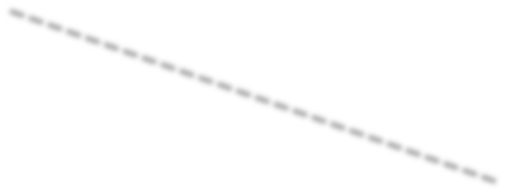



Simplification of Overlay Map
F(A, B, C, D, E) = Σ (3, 5, 6, 7, 9, 10, 11, 12, 13, 14, 17, 18, 19, 20, 21, 22, 24, 25, 26, 28)
C, D, E
A, B
000 001 011 010 100 101 111 110
00
0
0
1
0
0
1
1
1
01
0
1
1
1
1
1
0
1
11
1
1
0
1
1
0
0
0
0
1
1
1
1
1
0
1
10

Slide 80


5-Variable K-Map with Don’t Care Conditions
F(A, B, C, D, E)= Σ(1, 2, 3, 8, 9, 10, 12, 15, 16, 17, 18, 22, 26, 27)
+d(0, 4, 11, 19, 28, 30, 31)
A = 0
A = 1
D, E
D, E
00
01
11
10
B, C
00
01
11
10
B, C
x | 1 | 1 | 1
x | 0 | 0 | 0
1 | 0 | 1 | 0
1 | 1 | x | 1
00
1 | 1 | x | 1
0 | 0 | 0 | 1
x | 0 | x | x
0 | 0 | 1 | 1
00
01
01
11
11
10
10

Slide 81

Homework
Simplify the following Boolean function:
F(A,B,C,D,E)=Σ(0, 1, 2, 3, 8, 12, 15, 16, 17, 18, 19, 22, 28, 31)

Slide 82

K-Maps with Don’t Care Conditions
Sometimes, we have function where it doesn’t matter whether the output is 0 or 1; it can be either.
These are known as ‘DON’T CARE CONDITIONS’. Such conditions are marked with an ‘x’ in the map.
B, C
A
00 01 11 10
1 | x | x | 1
0 | x | 1 | 0
0
F(A, B, C)= Σ(0, 2, 7)+d(1, 3, 5 )
1

Slide 83

Map Simplification in the Presence of Don’t Care Conditions
B, C
A
00
01
11
10
1 | x | x | 1
0 | x | 1 | 0
0
F= A’+C
1

Slide 84
Combinational Circuits

Slide 85
Combinational Circuits
A combinational circuit is a connected arrangement of logic gates with a set of inputs and outputs.
Combinational Circuits
Half Adder
Full Adder

Slide 86
Adders
Addition is the most basic digital arithmetic operation.
A combinational circuit that adds two bits is called a HALF-ADDER
and
the one that adds three bits (i.e., two significant bits and a previous carry) is called a FULL-ADDER.

Slide 87
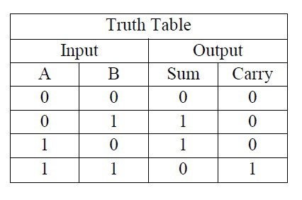
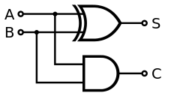
Half-Adder
Truth Table
Logic Diagram
S (sum)= A’B+AB’= A⊕B
C (carry)= AB

Slide 88
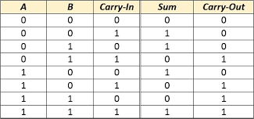
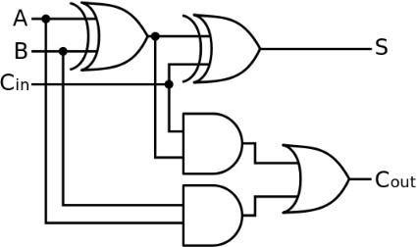

Full-Adder
Truth Table
Logic Diagram
S (sum)= A⊕B⊕C_{in}
C_{out} (carry)= AB+(A+B)C_{in}

Slide 89


Slide 90
Homework 1
Simplify the following Boolean functions:
F(A,B,C,D)=Σ(1, 3, 7, 8, 9, 12, 13, 14, 15)
F(A,B,C,D)=Π(0, 2, 4, 5, 8, 10, 12, 13)

Slide 91

Homework 2
Given the following Boolean function:
F=x+x’y’
List the truth table
Draw the logic circuit

Slide 92
Boolean Function Truth Table
F = x + x’ y’ | x | y | x’ | y’ | x’y’ | x+x’y’ (=F)

Slide 93
In the next lecture, we will study…
Flip – Flops
Sequential circuits
Decoders
Multiplexers
Registers

